Slide 1
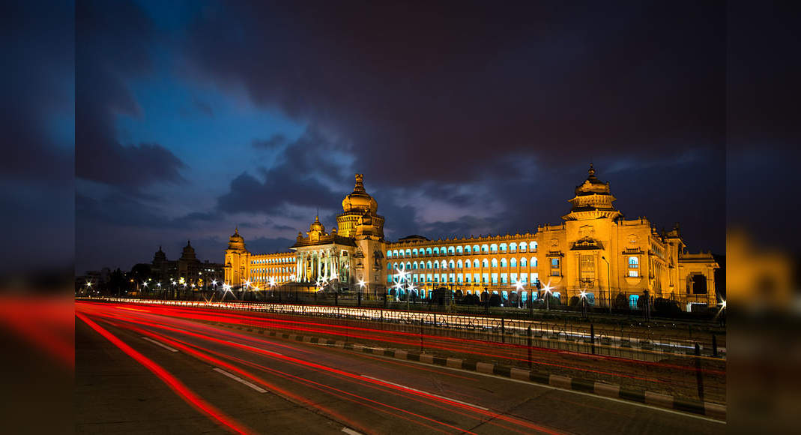
Applied Data Science Capstone-IBM
The Silicon Valley of India - Bangalore
_Mehatab

Slide 2
IBM Applied Data Science Capstone The Silicon Valley of India - Bangalore
Bangalore officially known as Bengaluru is the capital and the largest city of the Indian state of Karnataka. It has a population of more than 8 million and a metropolitan population of around 11 million, making it the third most populous city and fifth most populous urban agglomeration in India.
Located in southern India on the Deccan Plateau, at a height of over 900 m (3,000 ft.) above sea level, Bangalore is known for its pleasant climate throughout the year. Its elevation is the highest among the major cities of India.
Bangalore is widely regarded as the "Silicon Valley of India" (or "IT capital of India") because of its role as the nation's leading information technology (IT) exporter.
Indian technological organizations are headquartered in the city.
A demographically diverse city, Bangalore is the second fastest-growing major metropolis in India. Recent estimates of the metro economy of its urban area have ranked Bangalore either the fourth- or fifth-most productive metro area of India.
As of 2017, Bangalore was home to 7,700 millionaires and 8 billionaires with a total wealth of $320 billion. It is home to many educational and research institutions. Numerous state-owned aerospace and defense organizations are located in the city. The city also houses the Kannada film industry. It was ranked the most livable Indian city with a population of over a million under the Ease of Living Index 2020.

Slide 3
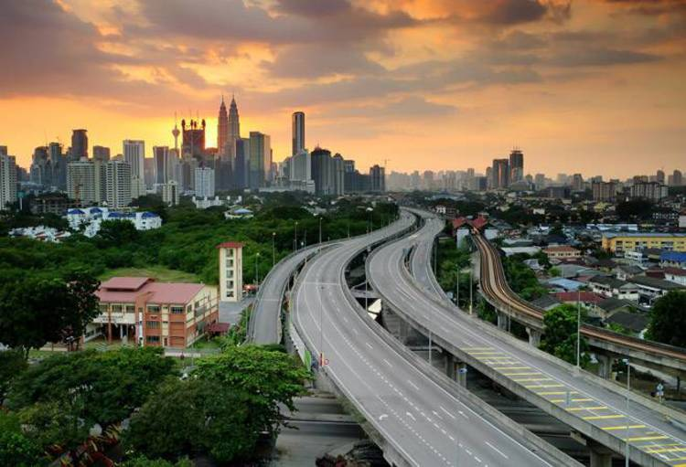
Identifying the issue
The city suffers, however, from some of the perennial problems of many large expanding industrial cities like - air and water pollution, widespread areas of substandard housing, and overcrowding. With its diverse society, comes diverse infrastructure which decides the quality of living.
Infrastructure in Bangalore is very spread out and unique - belonging to different categories like Drinking Water Plant, Waste Water/Sewage, Hospitals, Schools, Colleges, Railway Network, Electricity Power Plants, Telecommunication Support, Bank, Shopping malls, Supermarket, Gas Station, Hotels, Police Station, Café, medical shops, grocery shops, theatre, etc.
One of the main problems, when one moves to a new city, is finding a good area to live in, settle down and grow prosperously.

Slide 4
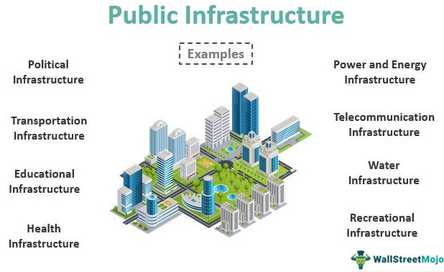
Defining the Business Problem
The questions which I aim to answer through this analysis are the following:
1. List and visualize all major parts of Bangalore with top existing infrastructure.
2. What are the best locations in Bangalore as per the existing infrastructure?
3. Which areas have the potential for the development of infrastructure of different kinds?
4. Which all areas lack the basic infrastructure facilities?
5. What is the best place to stay within the city for all vital infrastructure facilities?

Slide 5
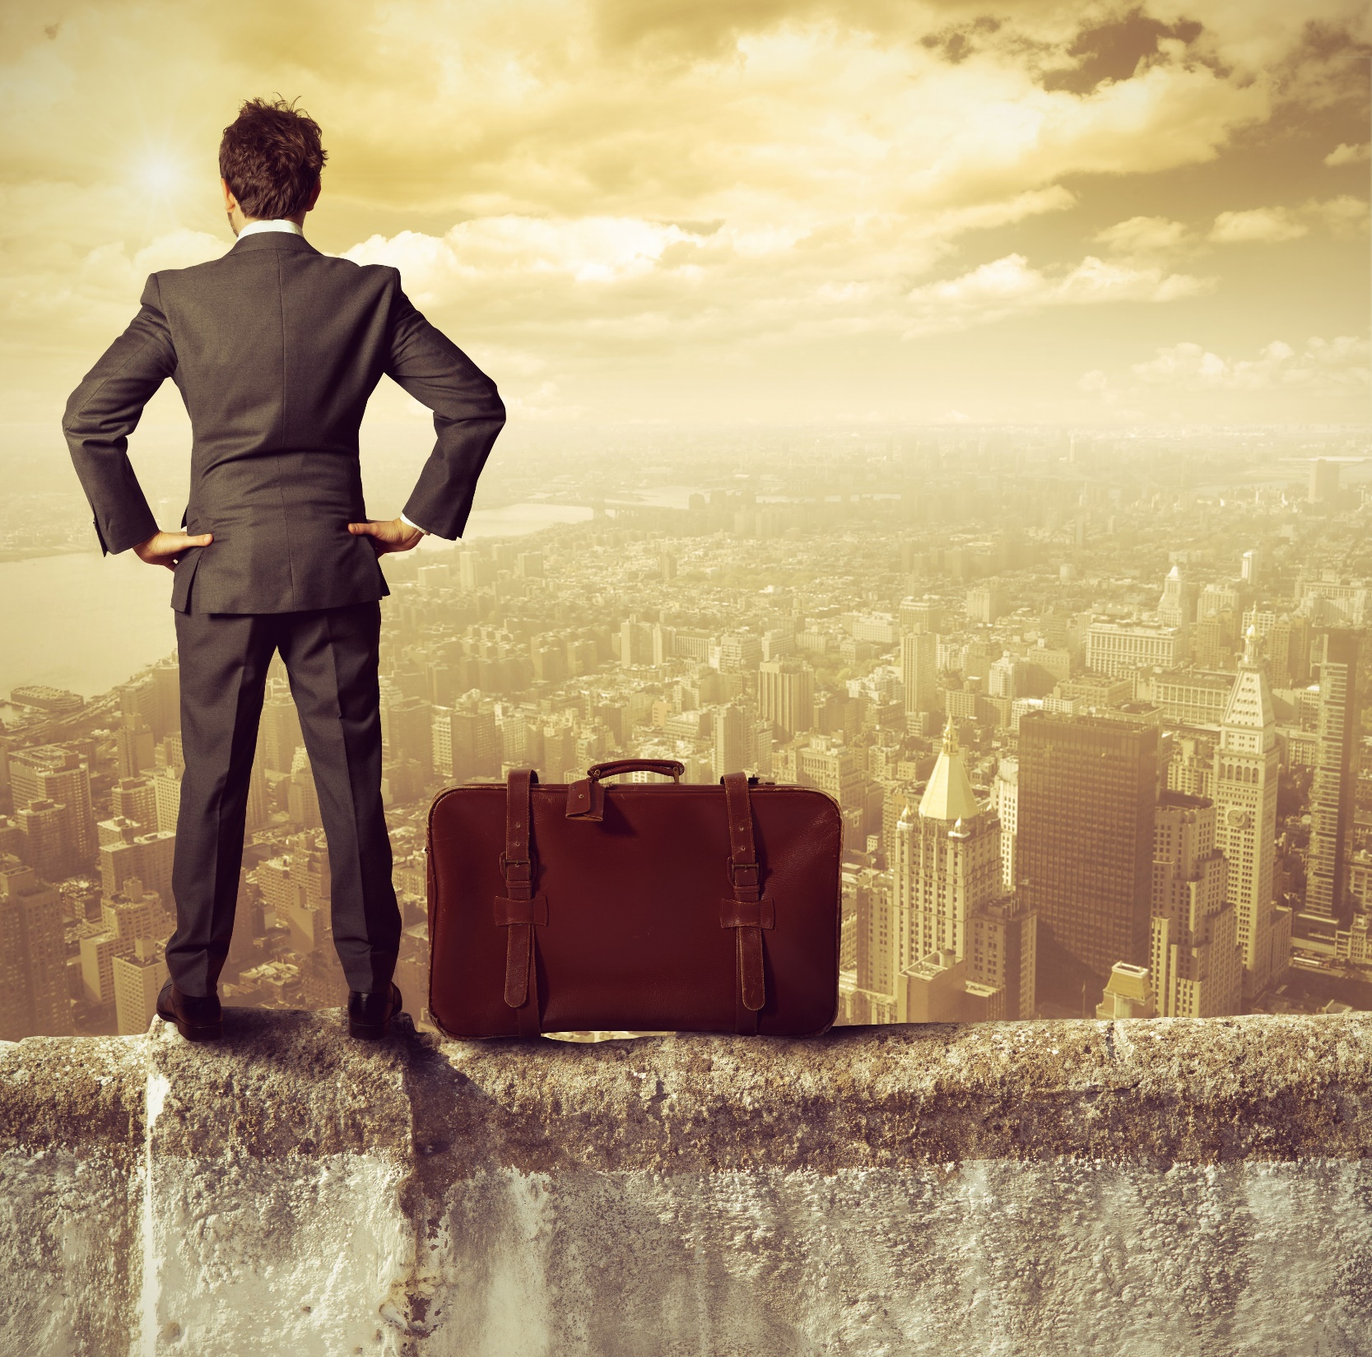
Target Audience
The purpose of this project is to help people in exploring better facilities around their neighborhood. It will help people making a smart and informed decision on selecting good neighborhoods in Bangalore, India.
Lot of people migrate from various states of India and need lots of research for good housing prices, new business, and reputed professional and safe places for their children. This project is for those people who are looking for better neighborhoods and businesses.
It will help people get the awareness of the area and neighborhood before moving to a new city, state, country, or place for their work or to start a new fresh life.

Slide 6
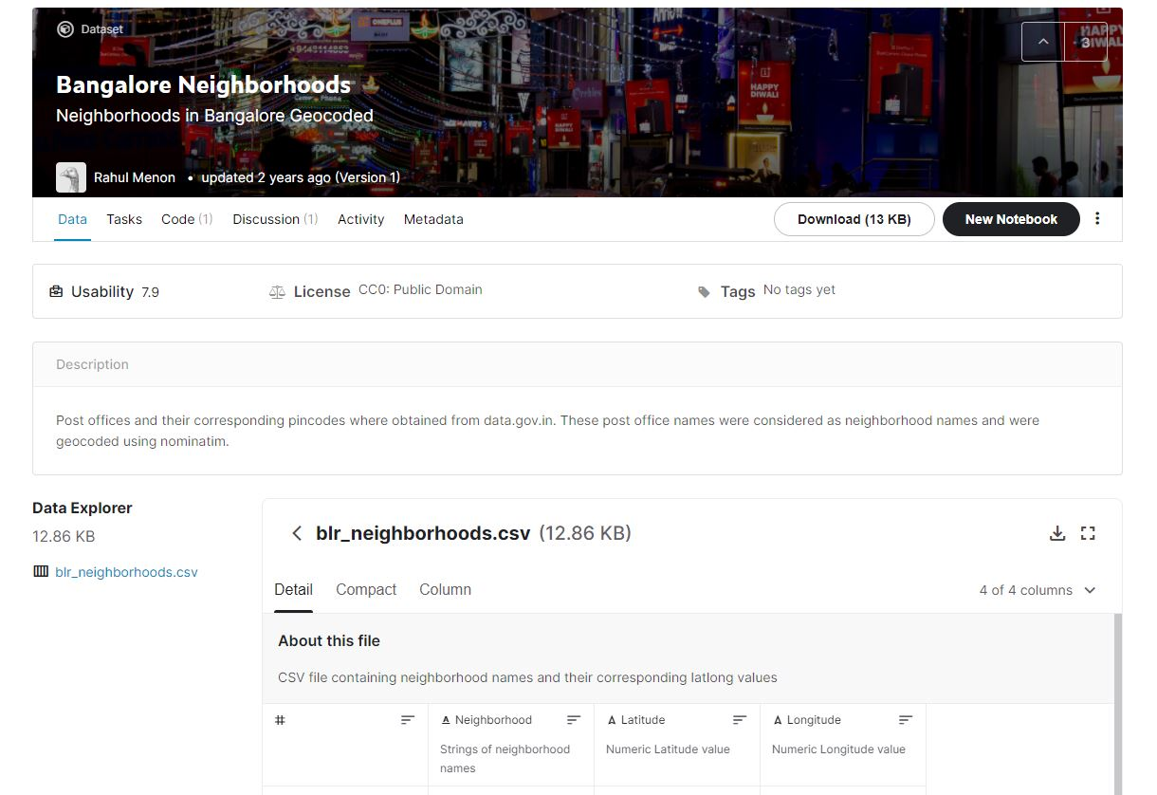
Data collection
Bangalore’s demographics show that it is a large and ethnically diverse metropolis. With its diverse society, comes diverse infrastructure. There are many different kinds of infrastructure in the city, each belonging to different categories like Hospitals, Schools, Colleges, Hotels, etc.
Bangalore Neighborhoods dataset is obtained from Kaggle consisting of the latitude and longitude values for all the neighborhoods in the city which will be used to obtain information about the nearby venues for Clustering.
South Indian restaurants and parks data retrieved from Foursquare API, which will be used to generate our ideal locations in the city and cluster them based on similarity for the user.

